Slide 1

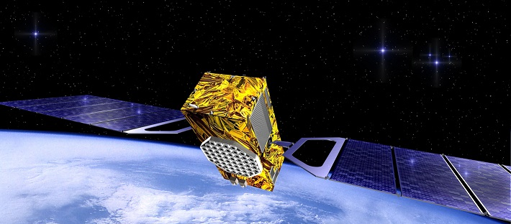
GNSS orbit monitoring with Where
M. Dähnn, G. A. Hjelle, A.-S. Kirkvik, I. Fausk, M. Ouassou, A. M. Solberg
Where workshop, Oslo, 6. November 2018

Slide 2
Part I
Background

Slide 3
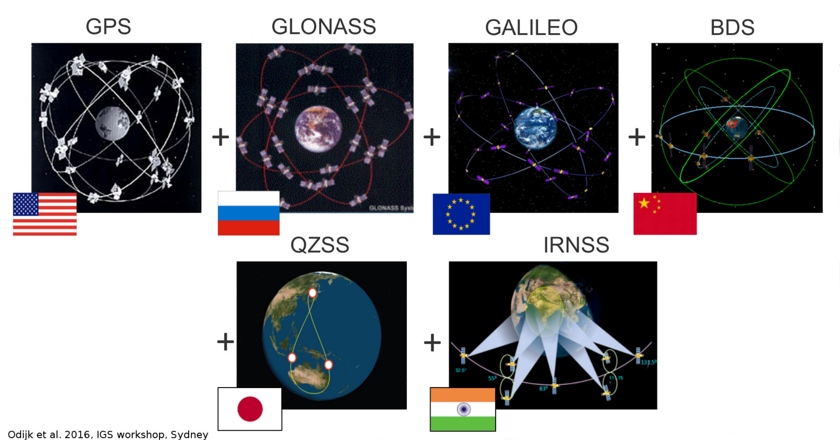
Notes:
GNSS: can be used for worldwide positioning -> satellites which moving around the earth are distributed so that worldwide positioning is possible

Slide 4
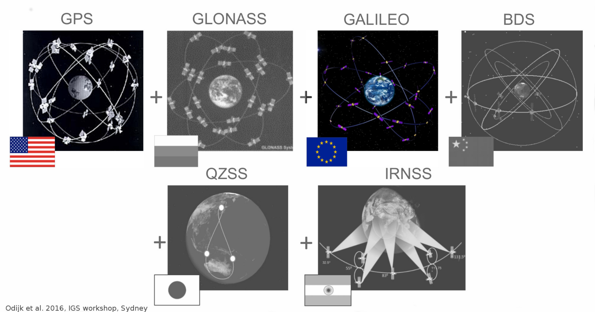
Notes:
- Involved in a european project called Galileo Reference Centre – Memberstate project

Slide 5
Notes:
- Galileo is more important in our section
- Involved in a European project called Galileo Reference Centre – Memberstate project
- Monitoring the performance of Galileo system

Slide 6
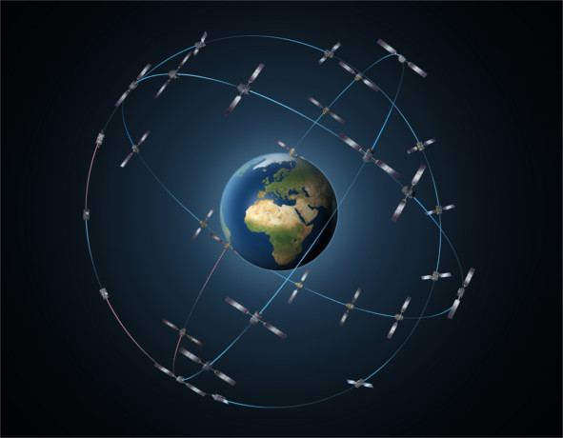
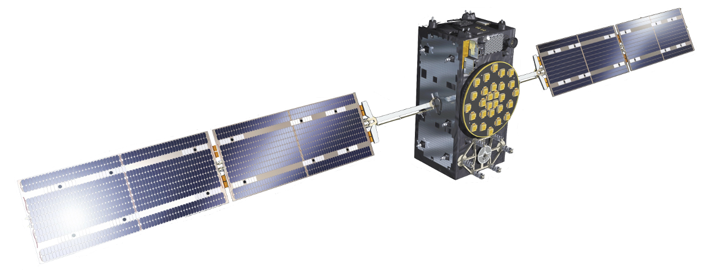


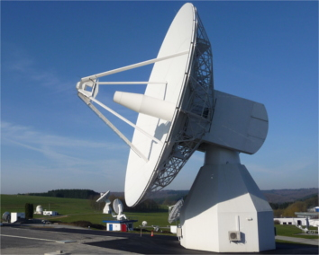
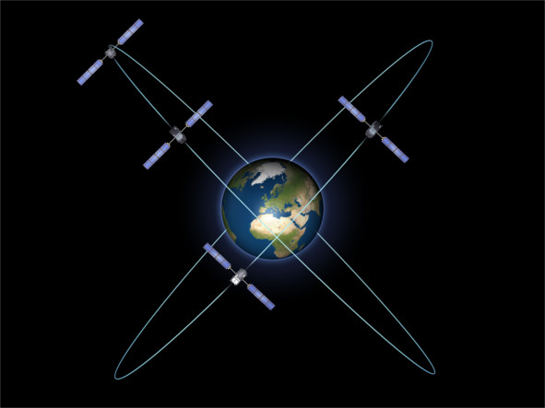
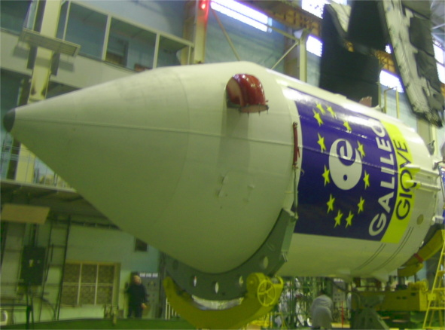
Galileo deployment
Full Operational
Capability
2020
Exploitation
Phase
2017
Initial Services
2016
In-Orbit Validation
2011-2013
Development
GIOVE A & B
2005/2008
Notes:
ESA launched two GIOVE satellites in 2005 and 2008 with a representative ground segment and securing the use of the frequencies (not used anymore)
-> testbed for onboard atomic clocks and navigation signal generation / GIOVE satellites are not longer active
in-orbit validation phase: initial validation of the system using four Galileo in-orbit validation IOV satellites (launched October 2011 and 2012)
-> first position fix in March 2013
Initial Services: 15th December 2016 declaration of initial service from European Commission; moving from testing phase to delivering of live service
-> ground infrastructure is operational and ready for positioning, navigation and timing to users; Galileo goes alive
Exploitation phase: routine operations, ground segment maintenance, filling up the satellite constellation
Galileo performance monitoring plays a important role for testing and verifying the initial services and to ensure the provision of high quality satellite data to users.

Slide 7
Galileo deployment
Full Operational
Capability
2020
Exploitation
Phase
2017
Initial Services
2016
In-Orbit Validation
4 IOV
2011-2013
Development
GIOVE A & B
2005/2008
Notes:
ESA launched two GIOVE satellites in 2005 and 2008 with a representative ground segment and securing the use of the frequencies (not used anymore)
-> testbed for onboard atomic clocks and navigation signal generation / GIOVE satellites are not longer active
in-orbit validation phase: initial validation of the system using four Galileo in-orbit validation IOV satellites (launched October 2011 and 2012)
-> first position fix in March 2013
Initial Services: 15th December 2016 declaration of initial service from European Commission; moving from testing phase to delivering of live service
-> ground infrastructure is operational and ready for positioning, navigation and timing to users; Galileo goes alive
Exploitation phase: routine operations, ground segment maintenance, filling up the satellite constellation
Galileo performance monitoring plays a important role for testing and verifying the initial services and to ensure the provision of high quality satellite data to users.

Slide 8
Galileo deployment
Full Operational
Capability
2020
Exploitation
Phase
2017
Initial Services
2016
In-Orbit Validation
4 IOV
2011-2013
Development
GIOVE A & B
2005/2008
Notes:
ESA launched two GIOVE satellites in 2005 and 2008 with a representative ground segment and securing the use of the frequencies (not used anymore)
-> testbed for onboard atomic clocks and navigation signal generation / GIOVE satellites are not longer active
in-orbit validation phase: initial validation of the system using four Galileo in-orbit validation IOV satellites (launched October 2011 and 2012)
-> first position fix in March 2013
Initial Services: 15th December 2016 declaration of initial service from European Commission; moving from testing phase to delivering of live service
-> ground infrastructure is operational and ready for positioning, navigation and timing to users; Galileo goes alive
Exploitation phase: routine operations, ground segment maintenance, filling up the satellite constellation
Galileo performance monitoring plays a important role for testing and verifying the initial services and to ensure the provision of high quality satellite data to users.

Slide 9
Galileo deployment
Full Operational
Capability
24
2020
Exploitation
Phase
2017
Initial Services
2016
In-Orbit Validation
4 IOV
2011-2013
Development
GIOVE A & B
2005/2008
Notes:
ESA launched two GIOVE satellites in 2005 and 2008 with a representative ground segment and securing the use of the frequencies (not used anymore)
-> testbed for onboard atomic clocks and navigation signal generation / GIOVE satellites are not longer active
in-orbit validation phase: initial validation of the system using four Galileo in-orbit validation IOV satellites (launched October 2011 and 2012)
-> first position fix in March 2013
Initial Services: 15th December 2016 declaration of initial service from European Commission; moving from testing phase to delivering of live service
-> ground infrastructure is operational and ready for positioning, navigation and timing to users; Galileo goes alive
Exploitation phase: routine operations, ground segment maintenance, filling up the satellite constellation
Galileo performance monitoring plays a important role for testing and verifying the initial services and to ensure the provision of high quality satellite data to users.

Slide 10

Motivation – Galileo performance monitoring
Space segment
testing and verifying the initial services
detecting anomalies (satellite faults)
ensure the provision of high quality satellite data to users
signal-in-space range error is a key performance indicator used from all GNSS
Control segment
User segment

Slide 11
Part II
What is signal-in-space range error (SISRE)?

Slide 12
What is signal-in-space range error (SISRE)?
Notes:
SISRE: modelling errors of the individual ranging measurements related to control and space segment
1. Receiver receives satellite signal and determines the range between the satellite and the receiver. This range is also called pseudorange because the satellite and receiver clock are not synchronized.
SISRE: Statistical uncertainty of the modeled pseudorange related to broadcast orbit and clock information.
Broadcast orbit and clock information depends on control and space segment. SISRE represents the error budget related to control and space segment.
Control Segment: Orbit and clock determination performance, distribution of monitoring stations, and upload capacity
5. Space Segment: Clock stability, satellite antenna variation, signal imperfection and predicability of orbital motion

Slide 13
What is signal-in-space range error (SISRE)?
SISRE: Statistical uncertainty of the modeled pseudorange related to
errors in the broadcast orbit and clock information.
SISRE
Notes:
SISRE: modelling errors of the individual ranging measurements related to control and space segment
1. Receiver receives satellite signal and determines the range between the satellite and the receiver. This range is also called pseudorange because the satellite and receiver clock are not synchronized.
SISRE: Statistical uncertainty of the modeled pseudorange related to broadcast orbit and clock information.
Broadcast orbit and clock information depends on control and space segment. SISRE represents the error budget related to control and space segment.
Control Segment: Orbit and clock determination performance, distribution of monitoring stations, and upload capacity
5. Space Segment: Clock stability, satellite antenna variation, signal imperfection and predicability of orbital motion

Slide 14
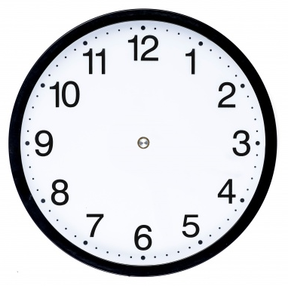
What is signal-in-space range error (SISRE)?
SISRE: Statistical uncertainty of the modeled pseudorange related to
errors in the broadcast orbit and clock information.
Space segment
Control segment
SISRE
Notes:
SISRE: modelling errors of the individual ranging measurements related to control and space segment
1. Receiver receives satellite signal and determines the range between the satellite and the receiver. This range is also called pseudorange because the satellite and receiver clock are not synchronized.
SISRE: Statistical uncertainty of the modeled pseudorange related to broadcast orbit and clock information.
Broadcast orbit and clock information depends on control and space segment. SISRE represents the error budget related to control and space segment.
Control Segment: Orbit and clock determination performance, distribution of monitoring stations, and upload capacity
Space Segment: Clock stability, satellite antenna variation, signal imperfection and predicability of orbital motion
- Control segment consists of different components (station network, control center, upload stations)

Slide 15
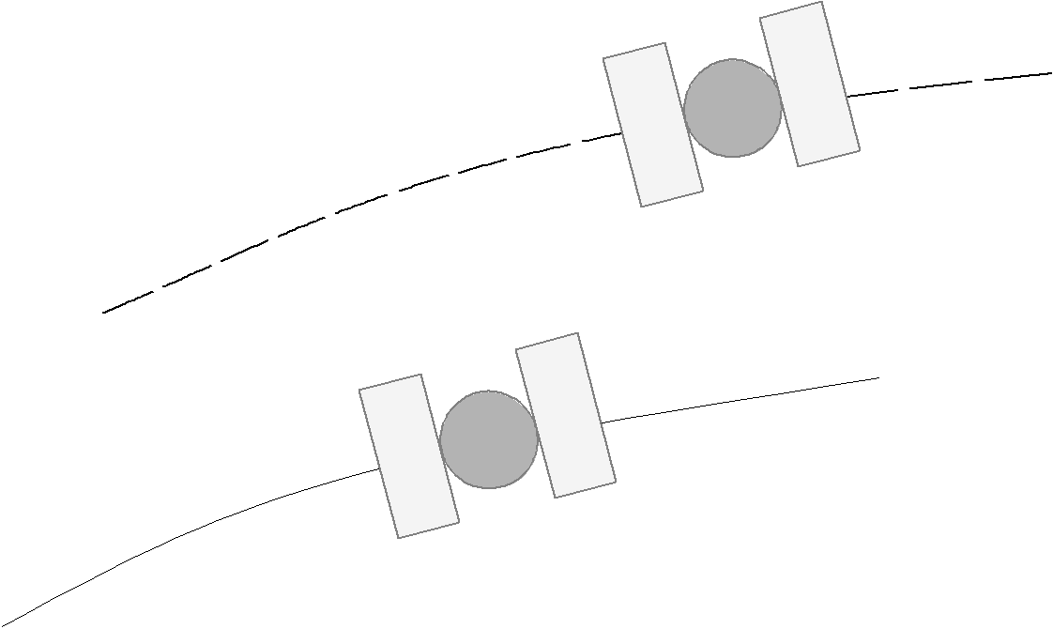
Broadcast orbit
Precise (true) orbit

Slide 16
Broadcast orbit
radial
along-track
.
Precise (true) orbit
.
cross-track
Earth
Notes:
Radial – vector to the Earth center
Along-track – lying orbital plane and shows more or less in the direction of satellite motion
Cross-track – fulfills a right hand system

Slide 17
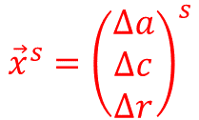
Broadcast orbit
radial
$${\vec{x}}^{s}={\left(\begin{matrix}∆a \\ ∆c \\ ∆r\end{matrix}\right)}^{s}$$
along-track
.
Precise (true) orbit
.
cross-track
Earth
Notes:
Radial – vector to the Earth center
Along-track – lying orbital plane and shows more or less in the direction of satellite motion
Cross-track – fulfills a right hand system

Slide 18
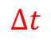
$$∆t$$
Broadcast orbit
radial
$${\vec{x}}^{s}={\left(\begin{matrix}∆a \\ ∆c \\ ∆r\end{matrix}\right)}^{s}$$
along-track
.
Precise (true) orbit
.
cross-track
Earth
Notes:
Radial – vector in the direction from Earth center to the satellite
Along-track – lying orbital plane and shows more or less in the direction of satellite motion
Cross-track – fulfills a right hand system

Slide 19
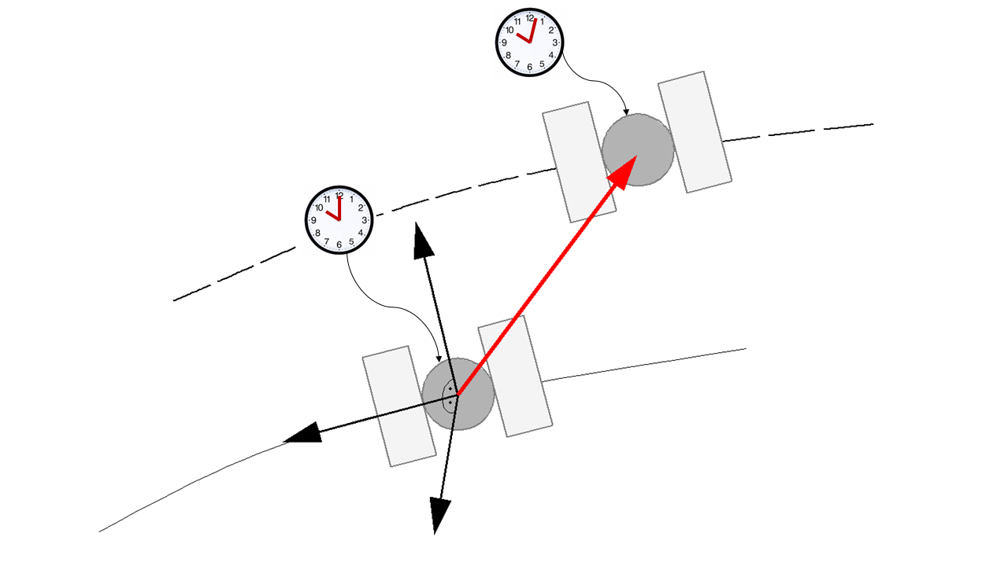
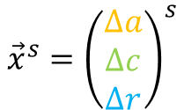
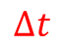
SISRE computation
$$∆t$$
$${\vec{x}}^{s}={\left(\begin{matrix}∆a \\ ∆c \\ ∆r\end{matrix}\right)}^{s}$$

Slide 20
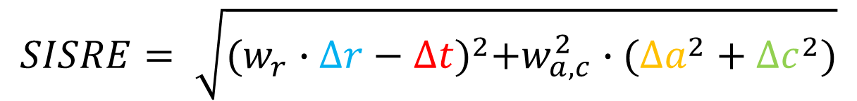
SISRE computation
$$∆t$$
$${\vec{x}}^{s}={\left(\begin{matrix}∆a \\ ∆c \\ ∆r\end{matrix}\right)}^{s}$$
$$SISRE= \sqrt{{(w_{r}∙∆r−∆t)}^{2}+w_{a,c}^{2}∙({∆a}^{2}+∆c^{2})}$$

Slide 21
SISRE computation
$$∆t$$
$${\vec{x}}^{s}={\left(\begin{matrix}∆a \\ ∆c \\ ∆r\end{matrix}\right)}^{s}$$
$$SISRE= \sqrt{{(w_{r}∙∆r−∆t)}^{2}+w_{a,c}^{2}∙({∆a}^{2}+∆c^{2})}$$
weight factors
Notes:
Global averaged SISRE: spatially independent (compared to instantaneous SISRE) – range error across the portion of the Earth in view of the satellite
Weight factors for radial and along-/cross-track errors
- Weight factors depend on:
- GNSS (lower altitude/orbital radius of satellites means lower weight factor)
- Elevation mask

Slide 22
Part III
SISRE implementation in Where

Slide 23
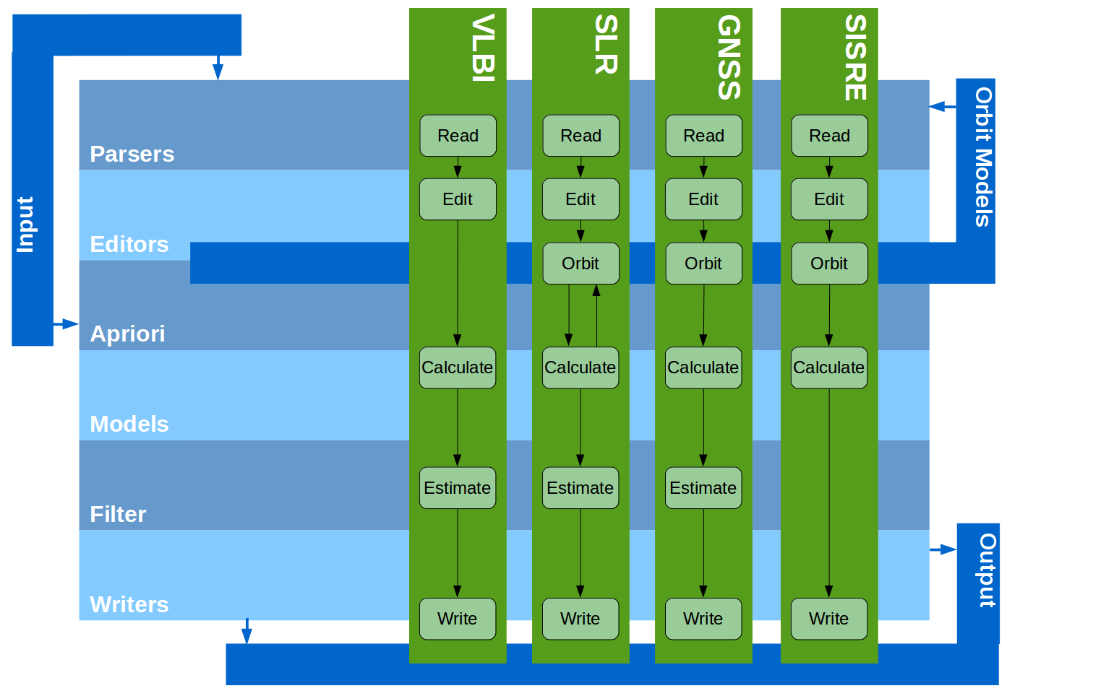
SISRE implementation in Where

Slide 24
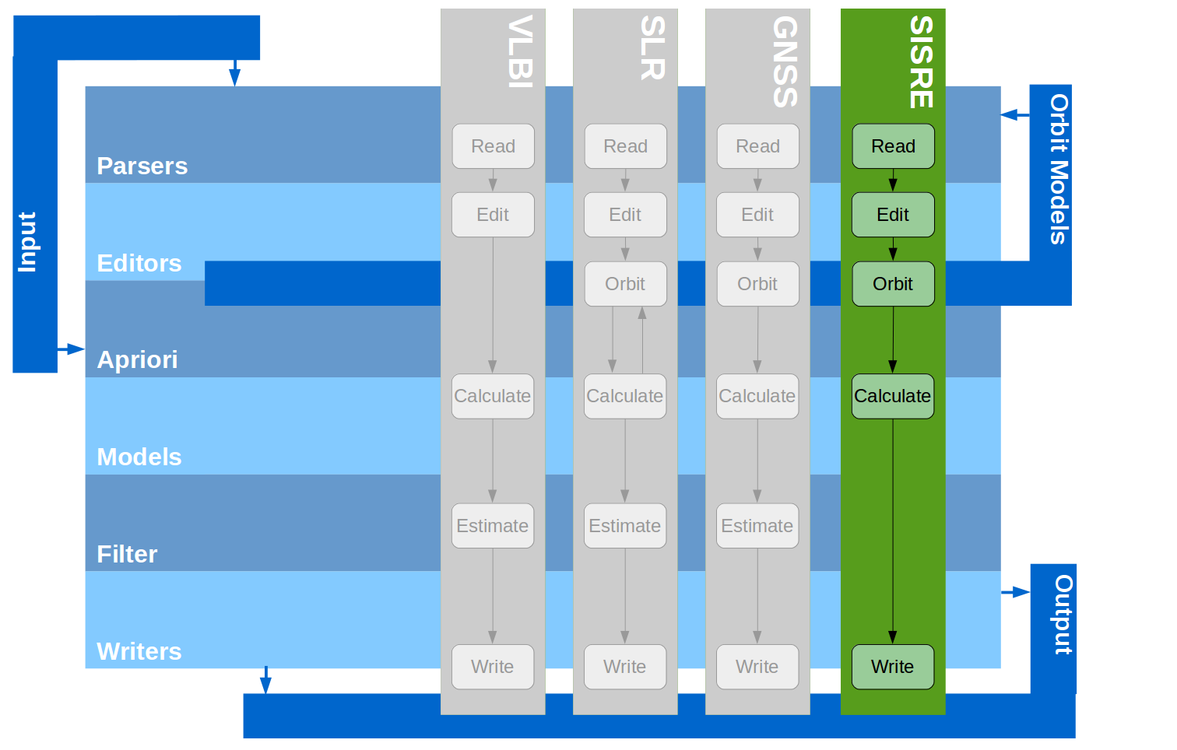
SISRE implementation in Where
Notes:
Edit: healthy satellites, remove duplicated broadcast ephemeris, choose navigation message (INVA, FNAV), use of observation for validity length
- Orbit: determine broadcast and precise orbit

Slide 25
Part IV
Results

Slide 26
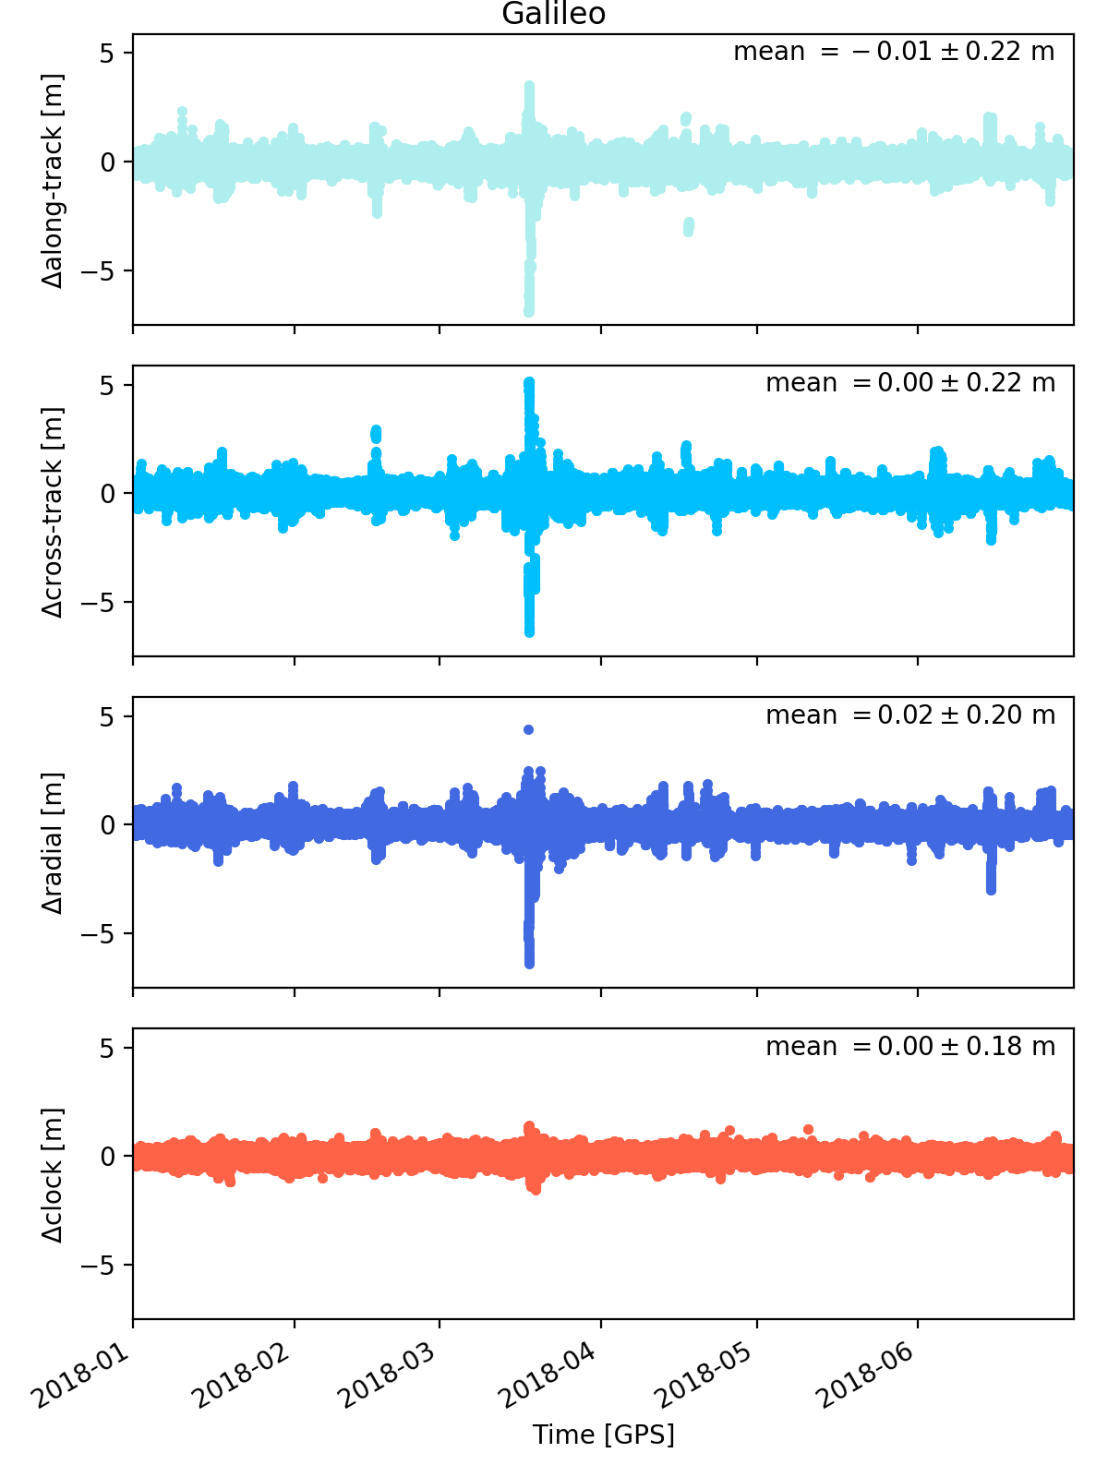
Galileo E1/E5a (FNAV)
Δalong-
track [m]
Δcross-
track [m]
Δradial [m]
Δclock [m]
Time [GPS]
Notes:
- In the Galileo open service provides to navigation messages:
FNAV: free navigation message (E5a)
INAV: integrity navigation message (E1 and E5b)
Half a year with data
Difference for all satellites of the Galileo constellation

Slide 27
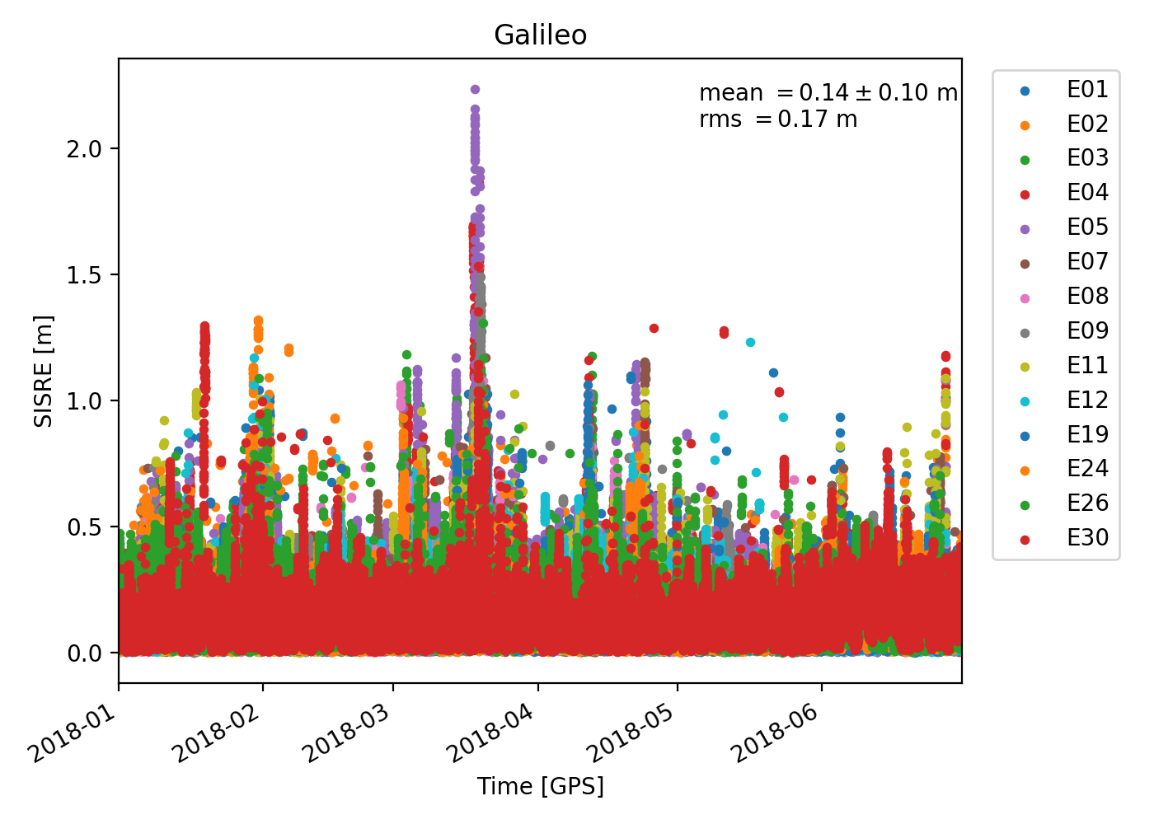
Galileo E1/E5a (FNAV)
RMS = 17 cm
Notes:
RMS – gives an indication of the spreadning of SISRE results

Slide 28
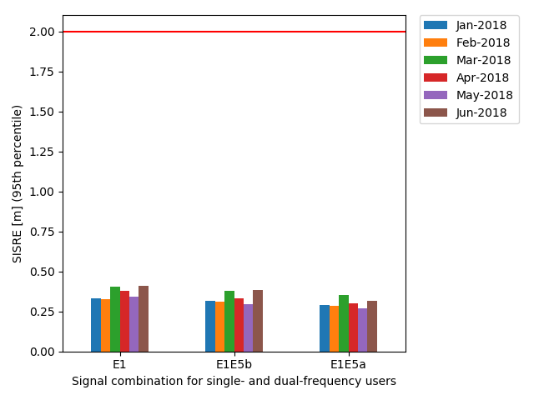
Galileo-OS-SDD (2016)
95% SISRE over all healthy satellites and a period of 30 days ≤ 2 m
SISRE 95th percentile [m]
E1 E1E5b E1E5a
INAV INAV FNAV
Notes:
Galileo Open Service definition document defines minimum performance level, where

Slide 29
Galileo-OS-SDD (2016)
95% SISRE over all healthy satellites and a period of 30 days ≤ 2 m
SISRE 95th percentile [m]
E1 E1E5b E1E5a
INAV INAV FNAV
E1 E1/E5b E1/E5a
INAV INAV FNAV
Notes:
Galileo Open Service definition document defines minimum performance level, where

Slide 30
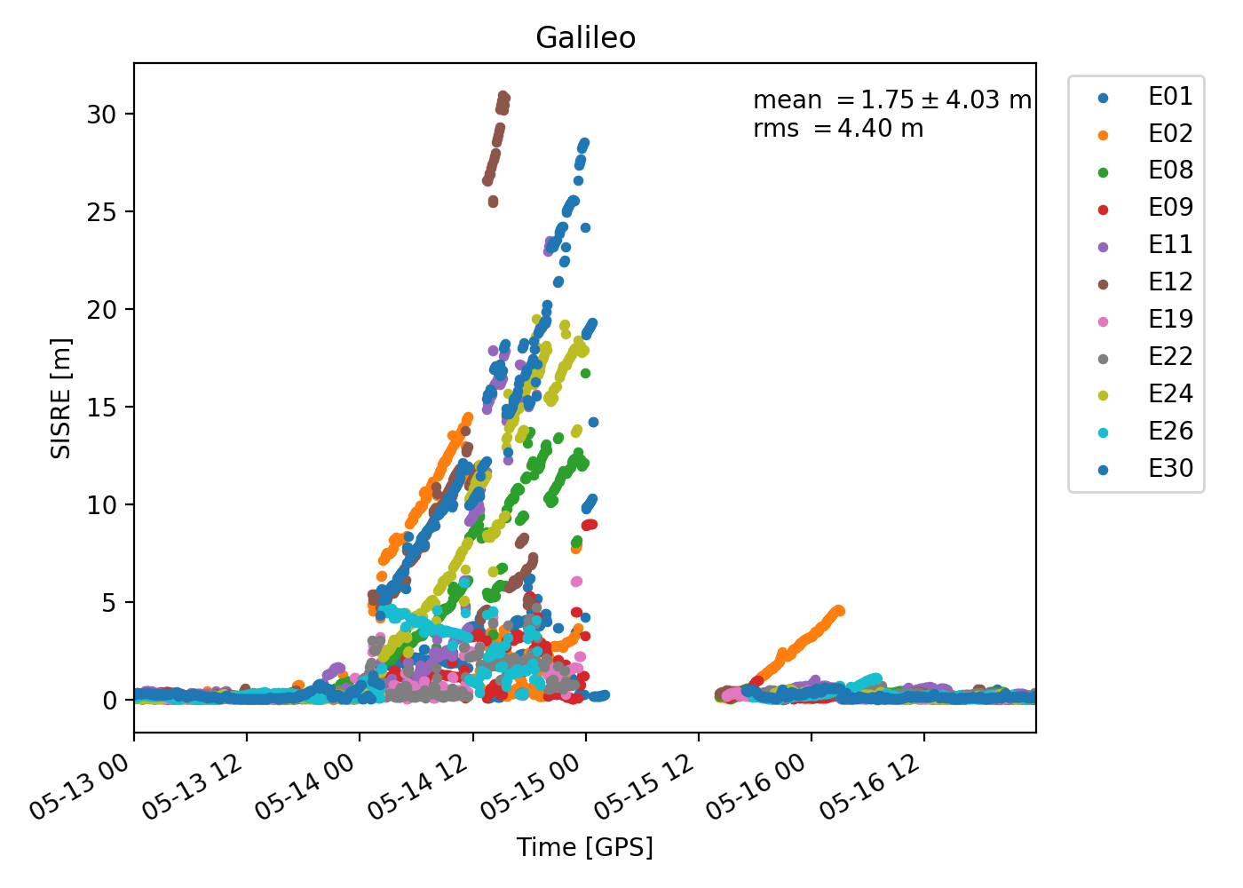
Galileo E1/E5a (FNAV)
Navigation messages
were not refreshed.
Time (May 2017)
Notes:
Anomaly: condition during a healthy and trackable satellite exceeds defined thresholds
Galileo navigation message are only valid for 4 hours

Slide 31
Part V
Conclusion and outlook

Slide 32
Conclusion and outlook
Galileo system fulfills SISRE minimum performance level for January to June 2018
Where SISRE solution shows comparable results to other studies (e.g. Montenbruck et. al (2018) or Galileo-IS-OS (2018)) with SISRE RMS of 17 cm and monthly 95th percentile of 25-40 cm
Further validation of Where SISRE analysis needed
Improvement of SISRE analysis by quality checking of input data
Notes:
Experience needed for detecting anomalies

Slide 33
Literature
Galileo-IS-OS (2018): European GNSS (Galileo) inital services – Open service quarterly performance report. January-March 2018.
Galileo-OS-SDD (2016): European GNSS (Galileo) inital services – Open service definition document. Issue 1.0, December 2016.
Galileo-OS-SIS-ICD (2015): European GNSS (Galileo) Open service – Signal in space inferface control document. Issue 1.2, November 2015.
Montenbruck, O., Steigenberger, P., and Hauschild, A. (2018): Multi-GNSS signal-in-space range error assessment – methodology and results. Advances in Space Research, 61(12):3020-3038. DOI 10.1016/j.asr.2018.03.041.
Notes:
Heng, L. (2012): Safe satellite navigation with multiple constellations: global monitoring of GPS and GLONASS signal-in-space anomalies. Department of Electrical Engineering, Stanford University.
Montenbruck, O., Steigenberger, P., and Hauschild, A. (2014): Broadcast versus precise ephemeris: a multi-GNSS perspective. GPS Solutions, (19):321-333. DOI 10.1007/s10291-014-0390-8.

Slide 34
Thank you for your attention!

Slide 35
SISRE implementation in Where
Broadcast ephemeris:
- IGS MGEX (BRDM) product derived from a subset of IGS stations
Precise ephemeris:
- IGS MGEX (CODE)
Notes:
Edit: healthy satellites, choose navigation message, use of observation for validity length
- Orbit: determine broadcast and precise orbit

Slide 36
SISRE implementation in Where
Ignore unhealthy satellites
Remove duplicated navigation messages
Select navigation message (INAV or FNAV) and valid navigation record
Remove epochs exceeding validity length of broadcast ephemeris (> 4 hours)
Notes:
Edit: healthy satellites, choose navigation message, use of observation for validity length
- Orbit: determine broadcast and precise orbit

Slide 37
SISRE implementation in Where
Determine broadcast orbit and satellite clock corrections based on GALILEO-OS-SIS-ICD (2015)
Interpolate precise orbit and clocks by using Lagrange and respectively linear interpolation
Notes:
Edit: healthy satellites, choose navigation message, use of observation for validity length
- Orbit: determine broadcast and precise orbit

Slide 38
SISRE implementation in Where
SISRE analysis in Where based on paper of Montenbruck et. al
(2018)
Relate satellite orbit and clock to center of mass by applying antenna phase center offsets
Apply constellation mean clock errors in each epoch
Correct satellite clock correction for differential code biases
Outlier rejection
Notes:
Epochwise mean orbit and clock correction: account for different GNSS time scale realization
Precise and broadcast clock correction can be based on different signal-linear combination/Correct satellite clock for DCBs: depend on the precise clock generation (Galileo: E1E5a) -> E1 + BGD and E1E5b + DCB
Data logging errors in broadcast and precise products affect resulting statistics unless the data are rejected (3-sigma range)

Slide 39
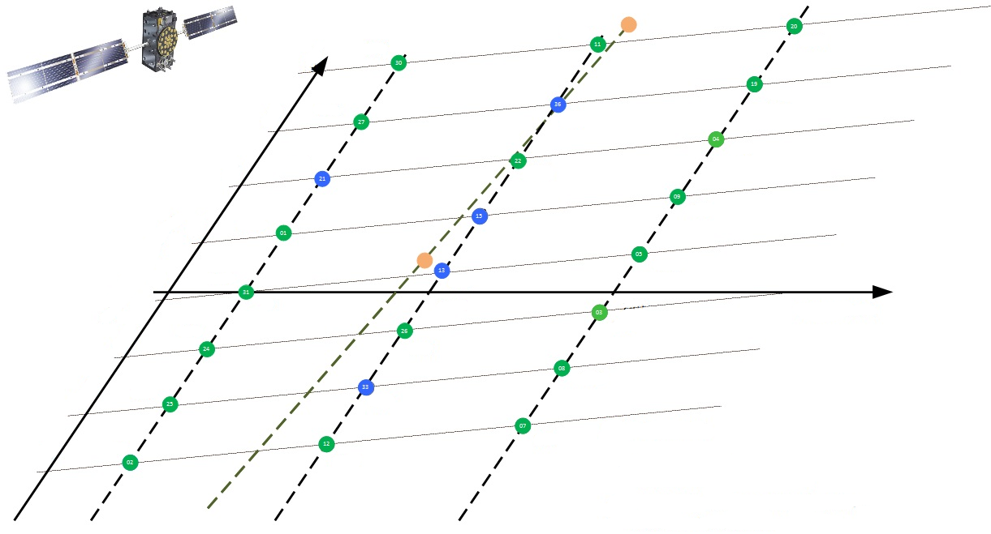
Galileo satellite constellation
20
11
180°
30
19
135°
36
27
04
90°
22
21
09
45°
15
Relative Mean Anomaly
01
05
0°
13
31
0°
120°
240°
03
Relative RAAN
315°
26
24
08
270°
33
25
12
07
Usable satellite (18)
225°
02
Under commissioning (4)/
Testing (2)
A plane
B plane
C plane
Not usable (2)
Notes:
E14/E18: on elliptic orbits in test mode
E20: has no ephemeris
E22: removed from active constellation for constellation management purposes
E13, E15, E21, E33, E36: under commissioning
RAAN and mean anomaly describes position of satellite
RAAN: right ascencion of ascending node (indicates where the orbital plane crosses the equator)
Mean anomaly: describes the motion of a fictitious satellite, which moves uniformly on a auxiliary circle with the radius a around the geocenter.

Slide 40
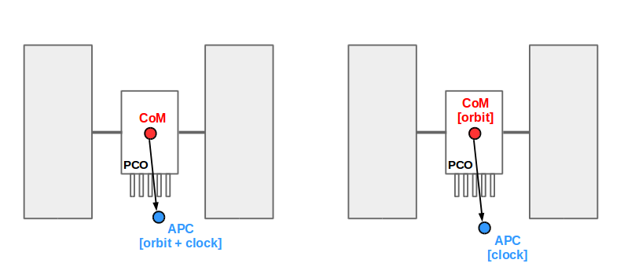
Satellite antenna relation
Broadcast orbit
Precise orbit
Relate orbit and clock differences to center of mass by applying PCOs given by GSC and IGS (igs14.atx)

Slide 41
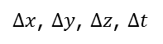
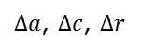
Broad-cast orbits
Difference between broadcast and precise orbit and clocks
Montenbruck et. al (2018)
IGS
DLR
$∆x$, $∆y$, $∆z$, $∆t$
Precise orbits
Transformation of orbital differences to local orbital reference frame
IGS
CODE
$∆a$, $∆c$, $∆r$
Phase center offset
Relate orbit and clock differences to center of mass by applying PCOs
IGS, GSC
Apply constellation mean orbit and clock errors in each epoch
DCBs
Correct satellit clock for DCBs
IGS
CAS
Outlier rejection
Compute SISRE
Notes:
CODE: Center of Orbit Determination in Europe
CAS: Chines Academy of Sciences
JPL: NASA Jet Propulsion Laboratory
Epochwise mean orbit and clock correction: account for different GNSS time scale realization
Correct satellite clock for DCBs: depend on the precise clock generation (Galileo: E1E5a) -> E1 + BGD and E1E5a + DCB
Data logging errors in broadcast and precise products affect resulting statistics unless the data are rejected (3-sigma range)

